Slide 1
Maze Project
Suxi Li

Slide 2
Table of Contents
Introduction
Design
Implementation
Test
Enhancement Ideas
Conclusion
References

Slide 3
Introduction
There is a ball in a maze with empty spaces and walls. The ball can go through empty spaces by rolling up, down, left or right, but it won't stop rolling until hitting a wall. When the ball stops, it could choose the next direction.
For this project, I am going to focus on using Breadth-First Traversal Algorithm to find the shortest path for the same maze.

Slide 4
Design
There is a ball in a maze with empty spaces and walls. The ball can go through empty spaces by rolling up, down, left or right, but it won't stop rolling until hitting a wall. When the ball stops, it could choose the next direction.
Given the ball's start position, the destination and the maze, determine whether the ball could stop at the destination.
The maze is represented by a binary 2D array. 1 means the wall and 0 means the empty space. You may assume that the borders of the maze are all walls. The start and destination coordinates are represented by row and column indexes.

Slide 5
Design
We can use the BFS method. In this case, we try to explore the search space on a level by level basis. i.e. We try to move in all the directions at every step. When all the directions have been explored and we still don't reach the destination, then only we proceed to the new set of traversals from the new positions obtained.
In order to implement this, we make use of a queue. We start with the ball at the startposition. For every current position, we add all the new positions possible by traversing in all the four directions(till reaching the wall or boundary) into the queue to act as the new start positions and mark these positions as True in the visited array. When all the directions have been covered up, we remove a position value, ss, from the front of the queue and again continue the same process with ss acting as the new start position.

Slide 6
Design
Further, in order to choose the direction of travel, we make use of a dir array, which contains 4 entries. Each entry represents a one-dimensional direction of travel. To travel in a particular direction, we keep on adding the particular entry of the dirs array till we hit a wall or a boundary. For a particular start position, we do this process of dirdir addition for all all the four directions possible.
If we hit the destination position at any moment, we return a True directly indicating that the destination position can be reached starting from the start position.

Slide 7
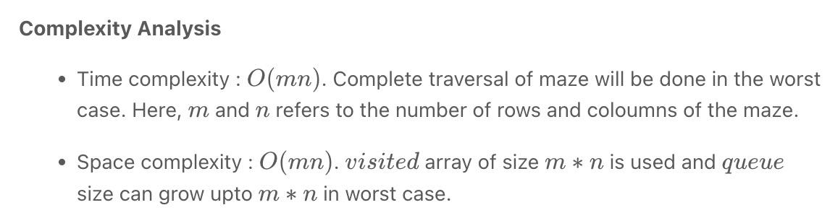
Design
Time Complexity: O(MN)
Space Complexity: O(MN)
M and N are length and width of rectangle

Slide 8
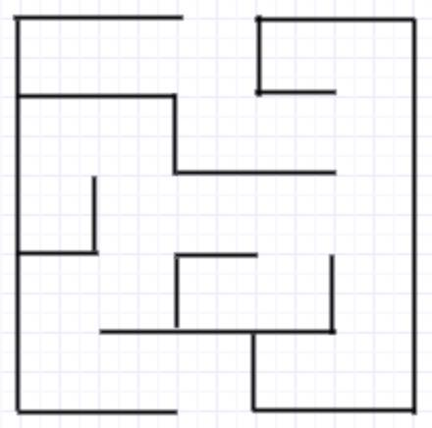
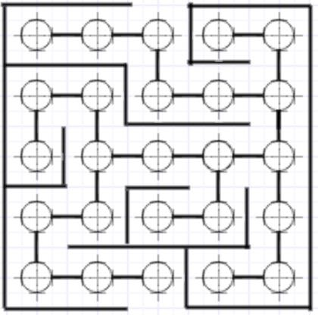
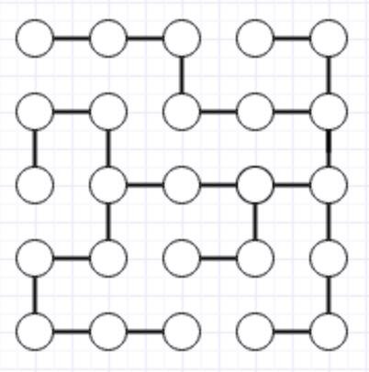
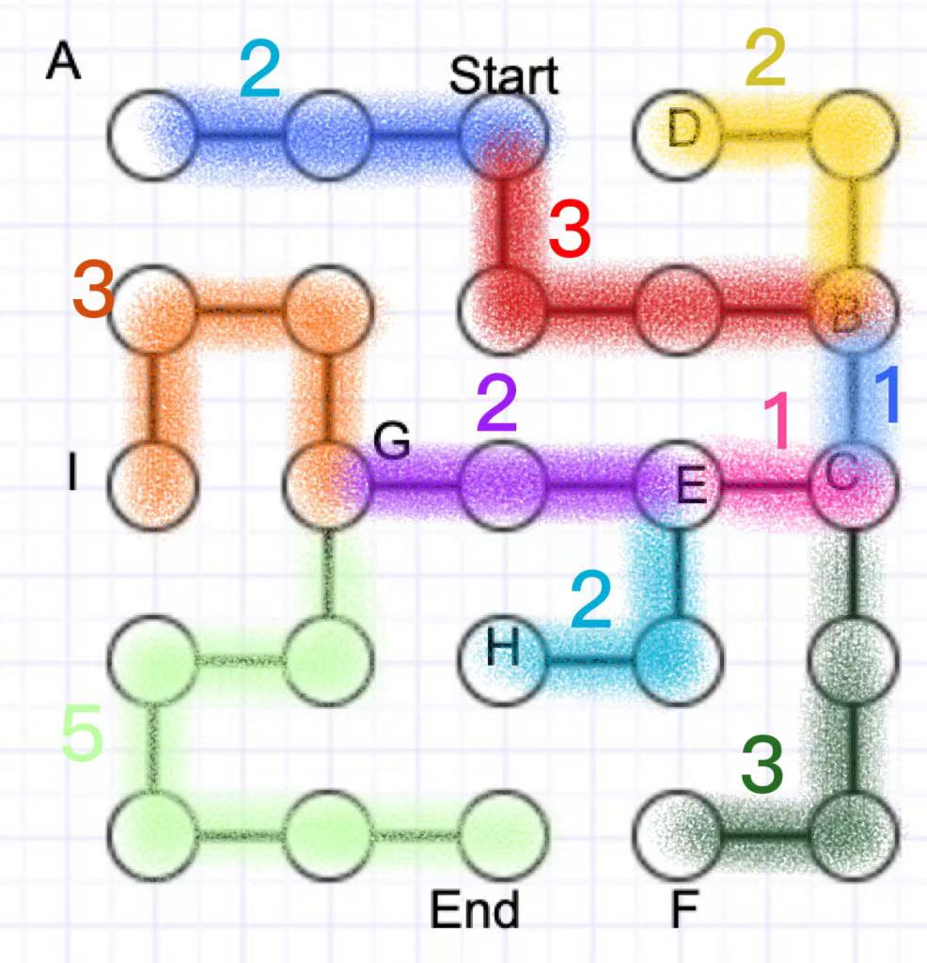
BFS - Tree

Slide 9
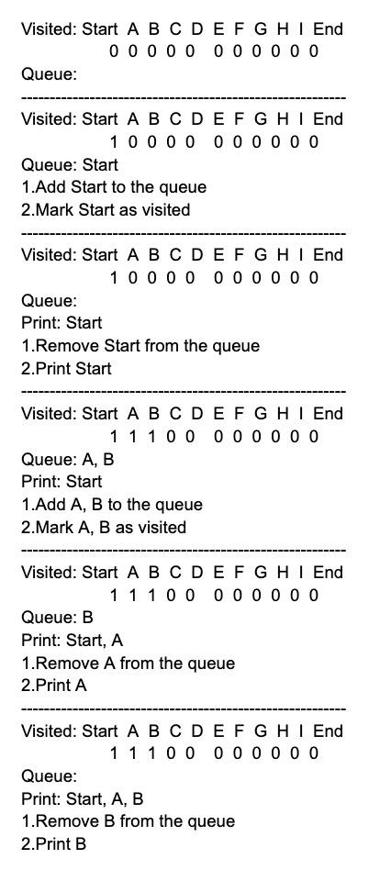
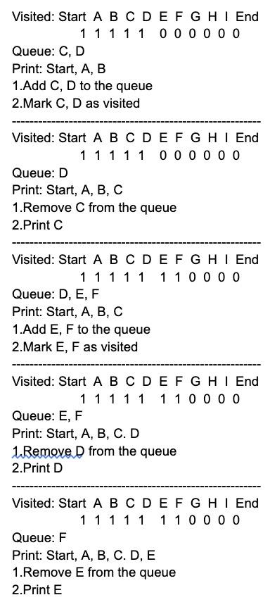
BFS - Tree

Slide 10
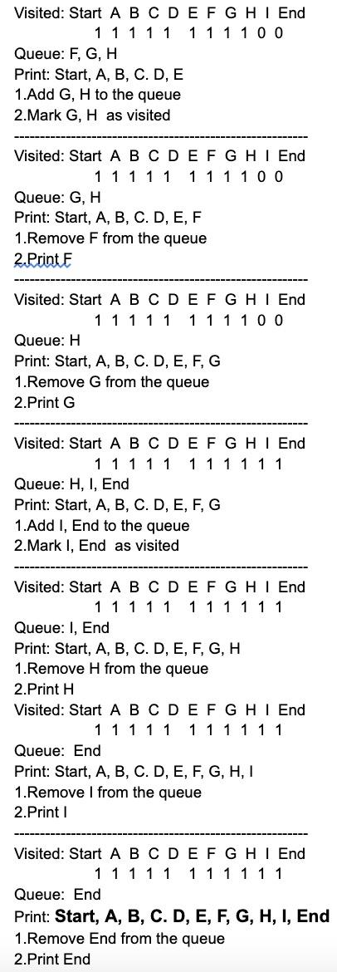
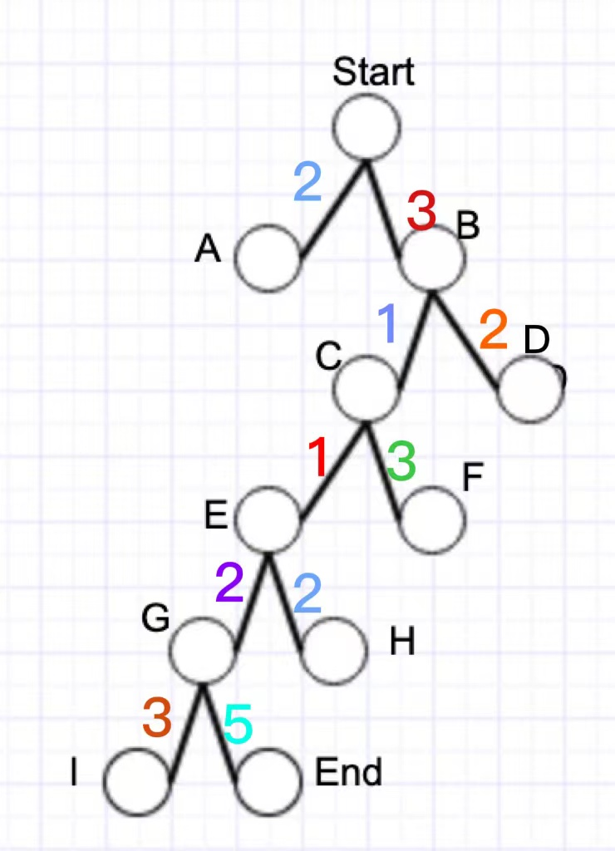
BFS - Tree

Slide 11
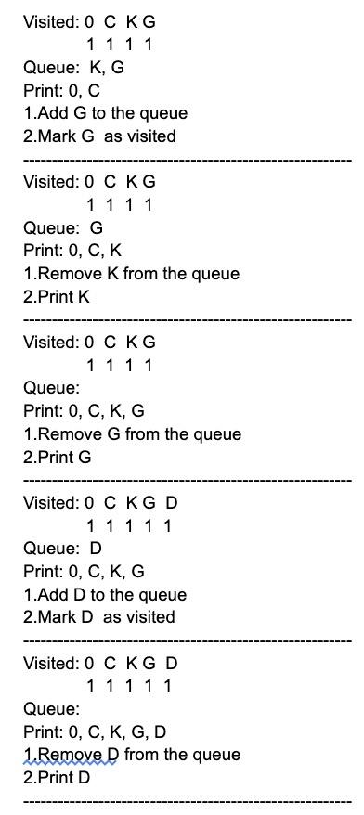
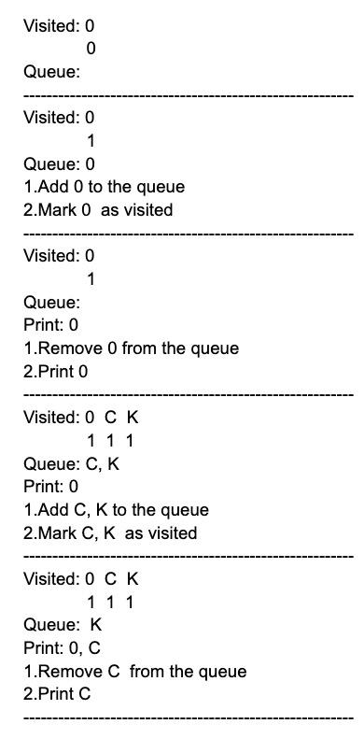
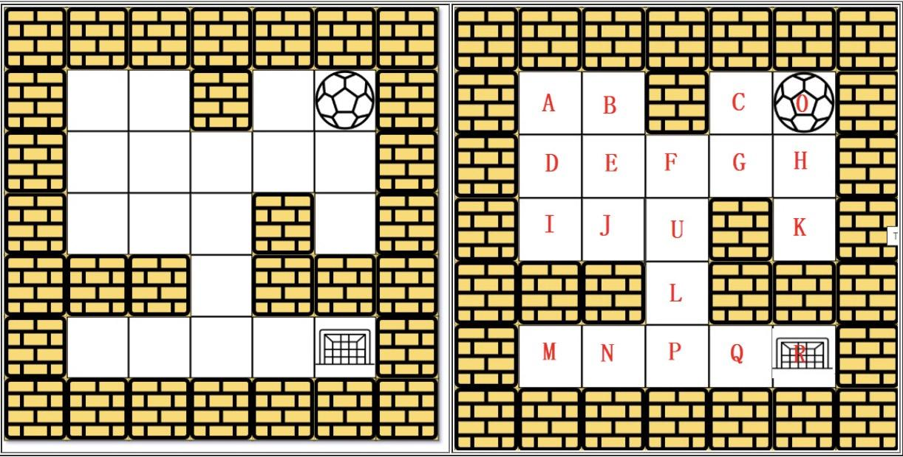
DFS - Matrix

Slide 12
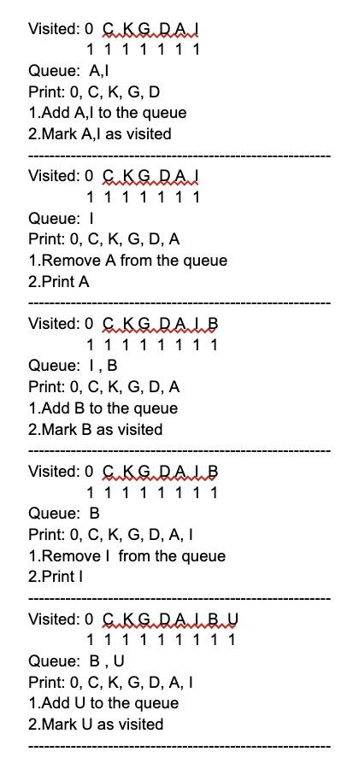
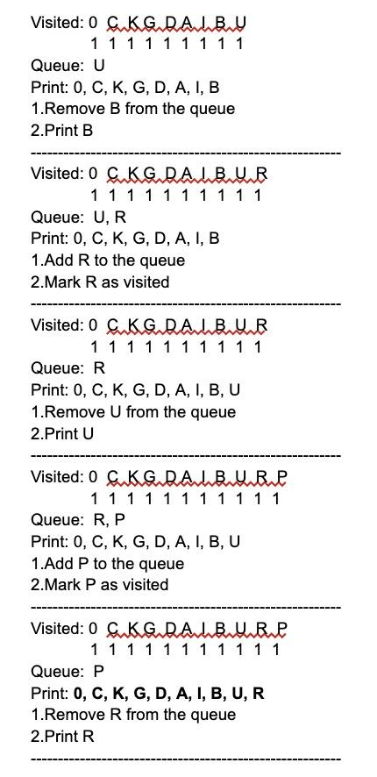
DFS - Matrix

Slide 13
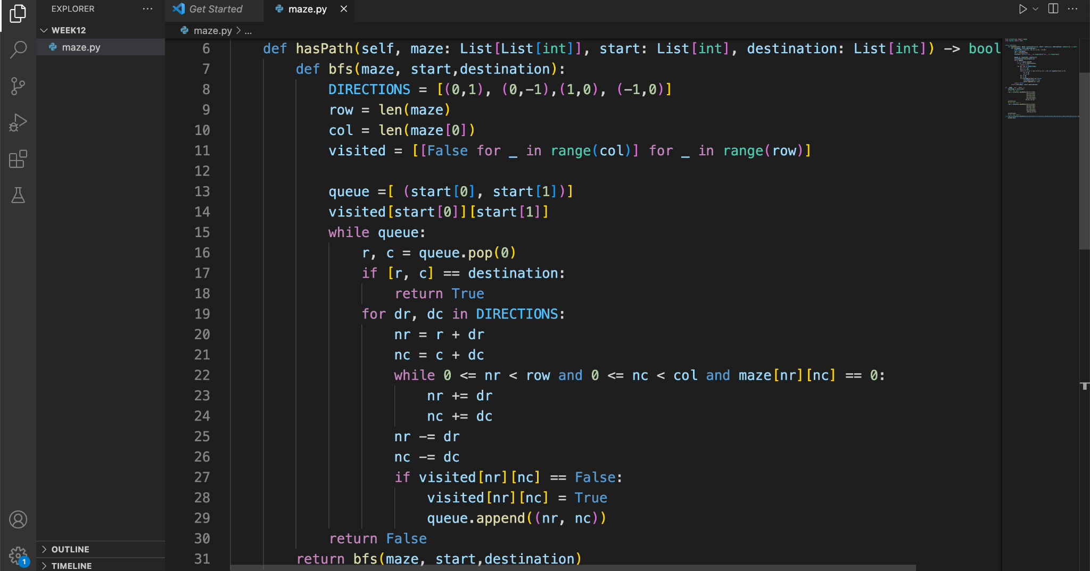
Implementation

Slide 14
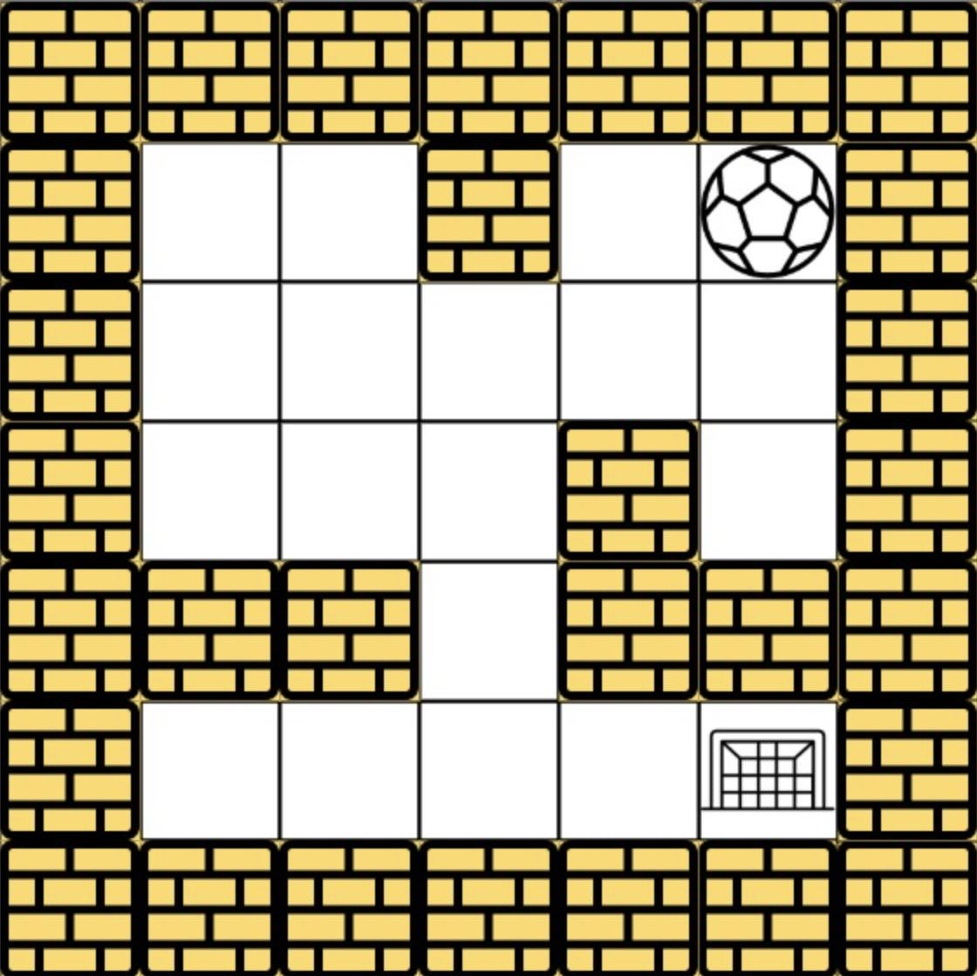
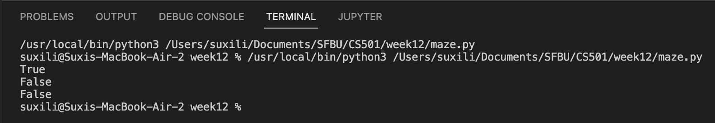
Test 1:
Input:
maze=[[0,0,1,0,0],[0,0,0,0,0],[0,0,0,1,0],[1,1,0,1,1],[0,0,0,0,0]], start = [0,4], destination = [4,4]
Output:

Slide 15
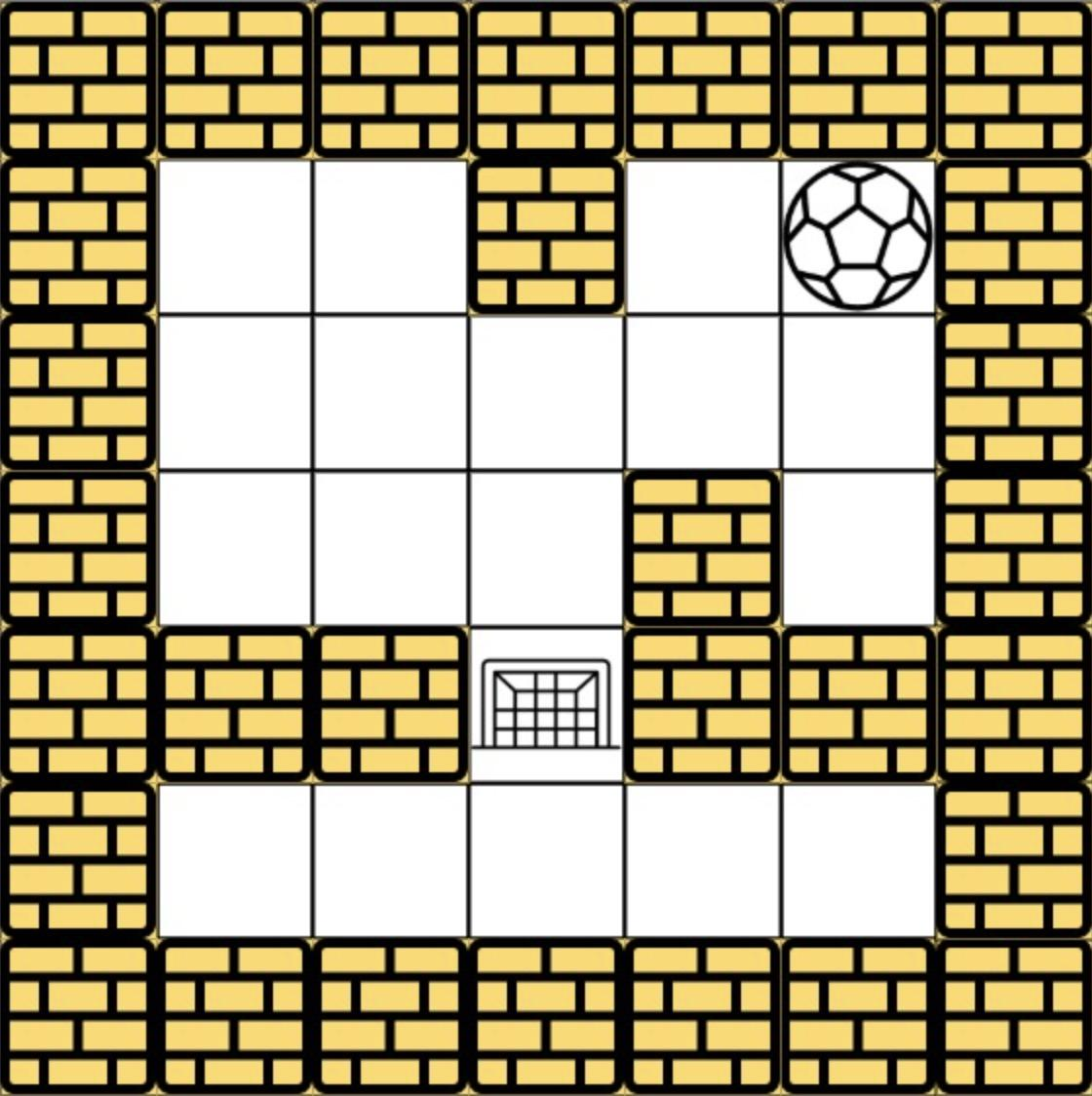
Test 2:
Input:
Maze=[[0,0,1,0,0],[0,0,0,0,0],[0,0,0,1,0],[1,1,0,1,1],[0,0,0,0,0]], start = [0,4], destination = [3,2]
Output:

Slide 16
Test 3:
Input:
maze=[[0,0,0,0,0],[1,1,0,0,1],[0,0,0,0,0],[0,1,0,0,1],[0,1,0,0,0]], start = [4,3], destination = [0,1]

Slide 17
Enhancement Ideas
At the end of a maze, find a way to avoid going to the end

Slide 18
Conclusion
From each starting position, we can keep moving left, right, up or down until we reach a boundary or a wall. Therefore, from the starting position, we identify all reachable ends by choosing four directions. In each case, the new endpoint will now serve as a new starting point for traversal. The destination clearly hasn't changed. So now we call the same function four times in four directions, each time using the previously obtained new starting point.
If any of the function calls return True, it means we can reach our destination.
Time complexity : O(mn)O(mn). Complete traversal of maze will be done in the worst case. Here, mm and nn refers to the number of rows and coloumns of the maze.
Space complexity : O(mn)O(mn). visited array of size m*nm∗n is used.

Slide 19
References
https://leetcode.com/problems/the-maze/
https://github.com/grandyang/leetcode/issues/490
https://www.geeksforgeeks.org/depth-first-search-or-dfs-for-a-graph/
https://www.youtube.com/watch?v=e_75Z90j0IM
https://www.youtube.com/watch?v=W9F8fDQj7Ok

